Slide 1
Phishing Awareness Training
CodeAlpha Cyber Security Internship
Prepared by: Firuza Abdullazade

Slide 2
Plan
Introduction to Phishing
How Phishing Works
Common Types of Phishing
Social Engineering Techniques
How to Identify a Phishing Email
How to Identify a Fake Website
Real-World Phishing Examples
Common Warning Signs
How to Protect Yourself
What to Do If You Clicked a Phishing Link
Interactive Quiz
Conclusion

Slide 3
What is Phishing?
Phishing is a cyberattack in which an attacker impersonates a trusted person, company, or service to trick a victim into revealing sensitive information or performing an unsafe action.
Attackers may try to obtain:
Usernames and passwords
Banking information
Credit card details
Personal information
Authentication codes
Company credentials
Access to internal systems
Main goal: Trick the victim rather than directly breaking the system.

Slide 4
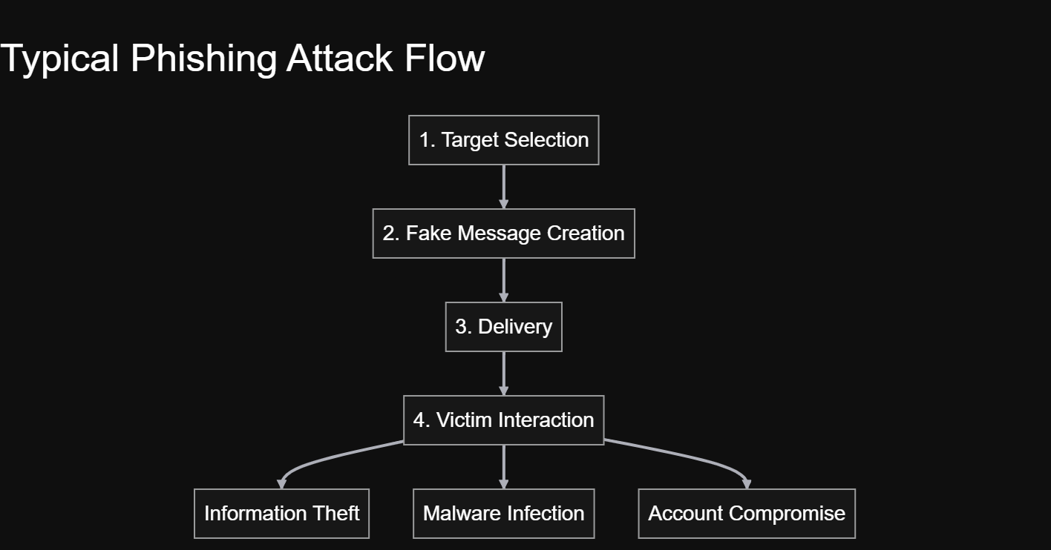
How Does Phishing Work?

Slide 5
Common Types of Phishing
Type | Description
Email Phishing | Fake emails sent to many users
Spear Phishing | Targeted attack against a specific person
Whaling | Targets executives or high-value individuals
Smishing | Phishing through SMS/text messages
Vishing | Phishing through phone calls or voice
Clone Phishing | Copying a legitimate message and replacing its content
Pharming | Redirecting users to fraudulent websites

Slide 6
Social Engineering
Social engineering is the manipulation of people into performing actions that compromise security.
Attackers commonly exploit:
🔴 Urgency
"You must act immediately."
🔴 Fear
"Your account will be suspended."
🔴 Authority
"Your manager requires this."
🔴 Curiosity
"See who viewed your profile."
🔴 Reward
"You have won a prize."
🔴 Trust
"This message is from your bank."

Slide 7
How to Identify a Phishing Email
Warning Signs
A phishing email often tries to make the recipient act quickly without thinking. Pay attention to the sender, the language used in the message, and any links or attachments.
Be careful when an email:
creates a strong sense of urgency;
comes from an unfamiliar or unusual address;
asks you to click a link, open an attachment, or provide sensitive information.

Slide 8
Example
Subject: ⚠️ URGENT: Your Account Will Be Deleted!
Dear Customer,
Your account will be permanently deleted within 24 hours.
Click here to verify your account immediately.
Why is this suspicious?
The message creates urgency, uses a generic greeting, and asks the recipient to verify the account through a link.

Slide 9
Check the Sender Address
Don't Trust the Display Name Alone
A phishing email can use a familiar company name to appear legitimate. However, the display name can be easily changed, so the actual email address is much more important.
Example
Display name: Microsoft Security
Email: security-alert@micros0ft-support.example
Suspicious: The name may look familiar, but the domain does not match the official organization.
What Should You Check?
Look carefully at the full email address, especially the domain. Small changes in spelling, unusual subdomains, or characters that look similar to the original can be signs of an impersonation attempt.
Remember: The name can be fake. Check the address.

Slide 10
How to Identify a Fake Website
Before entering your credentials, take a moment to check the website.
A phishing website may look almost identical to the real one. The most important thing is to look beyond the design and verify where the website actually leads.
🔎 Check the URL
Look at the domain carefully. Misspelled names, unexpected words, unusual subdomains, or unfamiliar domains can indicate a fake website.
Example:
login.microsoft.com → expected domain
login-microsoft-security.example → suspicious

Slide 11
🔒 Don't Rely on HTTPS Alone
HTTPS means that the connection is encrypted, but it does not guarantee that the website itself is legitimate. Phishing websites can also use HTTPS.
🔑 Think Before You Log In
If a website suddenly asks for your password, MFA code, recovery code, or banking information, stop and verify the request through an official channel.
A website can look real and still be fake. Always verify the address before logging in.

Slide 12
Real-World Example
⚠️ Security Alert — Action Required
From: Microsoft Security <security-alert@micros0ft-support.example>
To: user@example.com
Subject: Urgent: Unusual Sign-In Activity Detected
Dear Customer,
We detected unusual sign-in activity on your account. To keep your account secure, please verify your identity within 24 hours.
[ Verify My Account ]
If you do not complete the verification, your account may be temporarily restricted.
Thank you,
Microsoft Account Security Team

Slide 13
Phishing vs Legitimate Message
Remember:
STOP → CHECK → VERIFY
Phishing Message | Legitimate Message
Unexpected request | Expected communication
Strong urgency | Usually provides context
Suspicious sender | Expected sender/domain
Suspicious link | Trusted navigation
Requests sensitive information | Follows normal security procedures
Threatening language | Professional communication

Slide 14
How to Protect Yourself
🛡️ Best Practices
1. Use Multi-Factor Authentication
MFA provides an additional security layer.
2. Use Strong, Unique Passwords
Never reuse important passwords.
3. Keep Software Updated
Security updates fix known vulnerabilities.
4. Don't Open Unexpected Attachments
Verify the sender first.
5. Check Links Before Clicking
Hover over links on desktop when appropriate and inspect the destination.
6. Use a Password Manager
Password managers can help identify unexpected domains and prevent password reuse.
7. Report Suspicious Messages
Report phishing attempts to your organization or service provider.

Slide 15
What If You Clicked a Phishing Link?
Don't panic.
Step 1: Disconnect if malware activity is suspected.
Step 2: Close the suspicious page.
Step 3: If credentials were entered, change the password from a trusted device.
Step 4: Enable or reset MFA if necessary.
Step 5: Contact your organization or service provider.
Step 6: Monitor the affected account for suspicious activity.
Step 7: Report the incident.

Slide 16
Interactive Quiz
Question 1: You receive: "Your bank account will be blocked in 30 minutes! Click here immediately.“ What should you do?
A)Click immediately
B) Reply to the email
C) Contact the bank using an official channel
D) Forward it to friends
Question 2: Which is a phishing warning sign?
A) Unexpected urgency
B) Suspicious sender
C) Unexpected attachment
D) All of the above

Slide 17
Interactive Quiz
Question 3: Does HTTPS guarantee that a website is legitimate?
A) Yes
B) No
Question 4: What should you do before entering your password after receiving an unexpected email?
A) Click the link immediately
B) Verify the sender and website independently
C) Send your password to the sender
D) Ignore all security warnings

Slide 18
Phishing Prevention Checklist
Before Clicking:
☐ Do I know the sender?
☐ Is the sender address legitimate?
☐ Was I expecting this message?
☐ Is the request urgent or threatening?
☐ Does the link lead to the expected domain?
☐ Is an attachment expected?
☐ Is sensitive information being requested?
☐ Can I verify the request independently?
When in doubt — STOP and VERIFY.

Slide 19
Key Takeaways
Remember the 5 Rules
1. Think before you click.
2. Check the sender.
3. Verify the URL.
4. Never share credentials through unexpected requests.
5. Report suspicious activity.
Final Message
Cybersecurity is not only about technology.
Human awareness is also a critical security layer.

Slide 20
Thank you for your attention

